Slide 1




"Challenges for a just and sustainable energy transition in the global South: The case of Mexico”
Omar Masera and Luca Ferrari
Universidad Nacional Autónoma de México
Programa Nacional Estratégico de Energía CONACYT
“University of Leeds”
July 5th 2022
Notes:
La tecnología:
¿Bendición, amenaza, instrumento de control o liberación humana?
¿Quién cambia a quién? ¿Nos cambia la tecnología, nosotros la cambiamos a ella .... o el cambio es mutuo?
¿Qué opciones tenemos para convertir a la tecnología/innovación en un verdadero instrumento de desarrollo sustentable?
Algunos ejemplos de México:
Innovación inclusiva y ecotecnologías: El Proyecto de estufas ecológicas Patsari

Slide 2
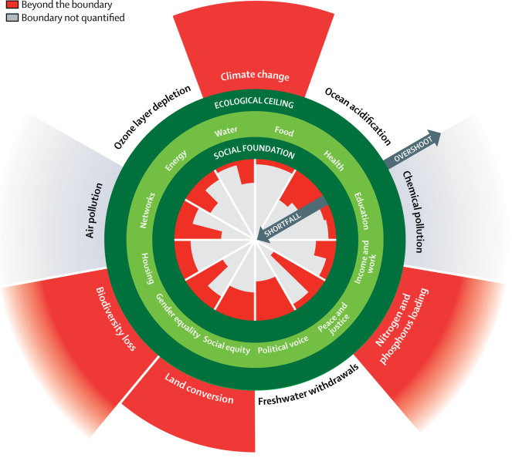
Finding a safe and just space for everybody
From
Growth
Consumption
Globalization
Competition
Individualism
Inequity
Centralized top-down governance
Fossil Fuels
To
Degrowth -- “Buen Vivir”
Sufficiency
Localization
Cooperation
Equity
Decentralized bottom-up governance
Local Renewables

Slide 3
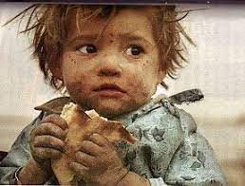

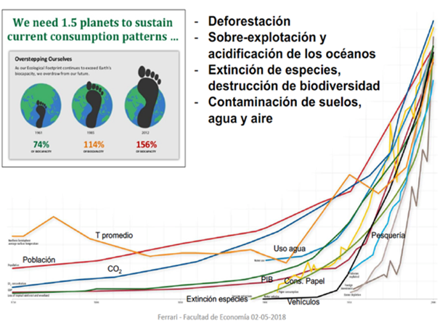
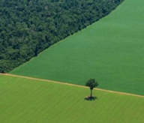
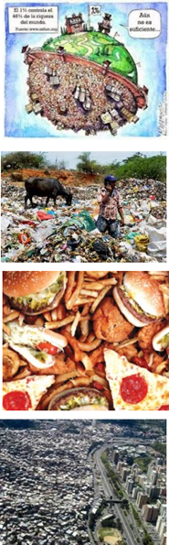
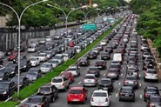
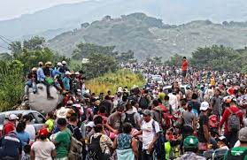

The end of a fossil-fuel based global capitalism (this is not just “another crisis”)
Exponencial growth of consumption
Fossil-fuel based economy
Abject Poverty and Abject Wealth
Increasing inequity
Migration
Violence/Racism
Gender inequality
Violence against women indigenous people
Waste!!
Unsustainable Mega Cities
Climatic Emergency
Biodiversity Loss
Unhealthy diets –obesity, cardio-vascular, cancer-
Precarious Public Health Systems
The “anthropocene” and the “great acceleration “
Notes:
Desigualdad– 87 personas la mitad de la riqueza mundial; 900 millones de pobres;
Basura --- 2,000 millones de ton de basura -- BM, 2018 se espera que llegue a 3,400 millones en 2050; 16% se recicla
Comida --- 1,300 millones de ton de comida se tiran; 30% se desperdicia, 30% se tira – puede alimentar a 900 millones hab; 2,000 millones de obesos
Desforestación 13 millones/ha año; se han perdido 2,000 millones de ha históricamente
Ciudades 700 millones de personas viven en las 37 megaciudades (10% del total mundial)
Coches --- 1,200 millones en circulación, en USA casi 1 coche/cápita
Petróleo – 80% consumo de energía

Slide 4
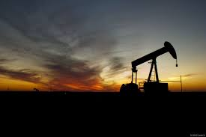
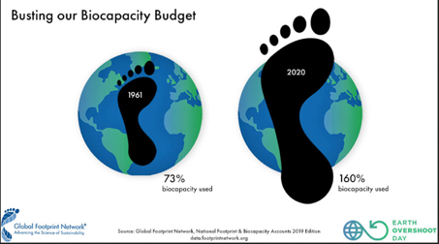
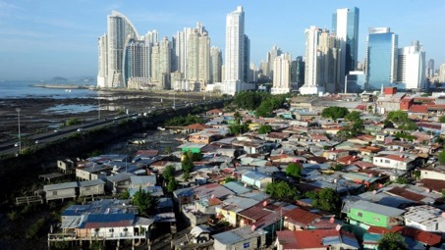
The civilizational crisis in the contemporary world:
The converging material, ecological and social crisis
Material Crisis (peak energy and raw materials)
Limit to the production of oil and non-renewable raw materials. We cannot keep growing, and neither we can make industrial civilization work with renewable sources.
Planetary boundaries
Ecological Crisis
Limit of the planet biocapacity: climate change but also pollution of water, air, soils, destruction of ecosystems, mass extinctions etc.
Social Crisis
Growing inequality in consumption, wasteful and polluting minority vs majority of population in energy poverty.
Social and political instability.
Capitalist system
Notes:
The civilization crisis is the sum of three converging crisis resulting from the infinite growth paradigm and the capitalism system. The Anthropocene have been also defined as Capitalocene. (Note: the growth paradigm is central also to the soviet or Maoist communist system)

Slide 5
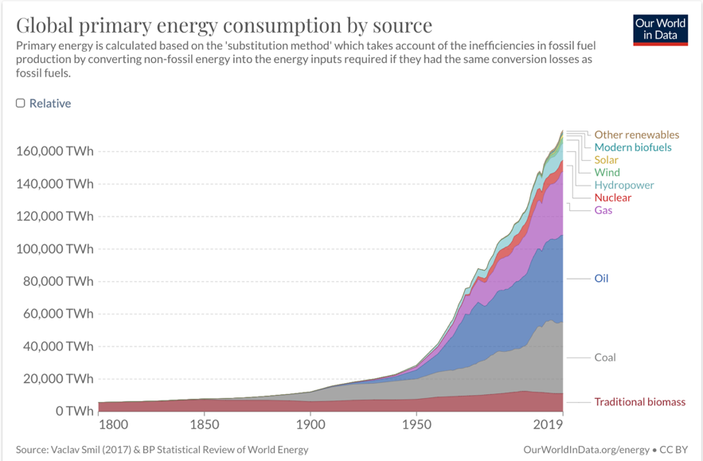
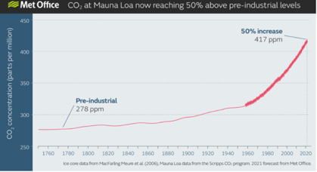
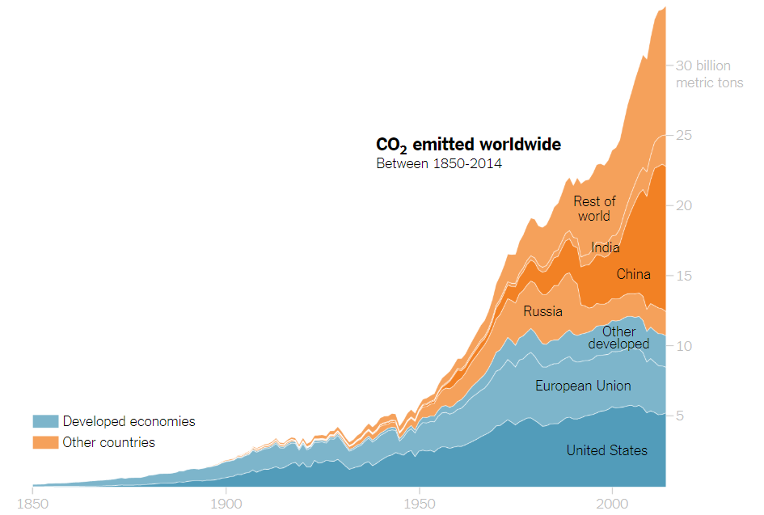
Climate Emergency: A direct impact from fossil fuels
Fossil fuels account for more than 80% of global energy use and up to 70% of global GHG emissions
Notes:
Desigualdad– 87 personas la mitad de la riqueza mundial; 900 millones de pobres;
Basura --- 2,000 millones de ton de basura -- BM, 2018 se espera que llegue a 3,400 millones en 2050; 16% se recicla
Comida --- 1,300 millones de ton de comida se tiran; 30% se desperdicia, 30% se tira – puede alimentar a 900 millones hab; 2,000 millones de obesos
Desforestación 13 millones/ha año; se han perdido 2,000 millones de ha históricamente
Ciudades 700 millones de personas viven en las 37 megaciudades (10% del total mundial)
Coches --- 1,200 millones en circulación, en USA casi 1 coche/cápita
Petróleo – 80% consumo de energía

Slide 6
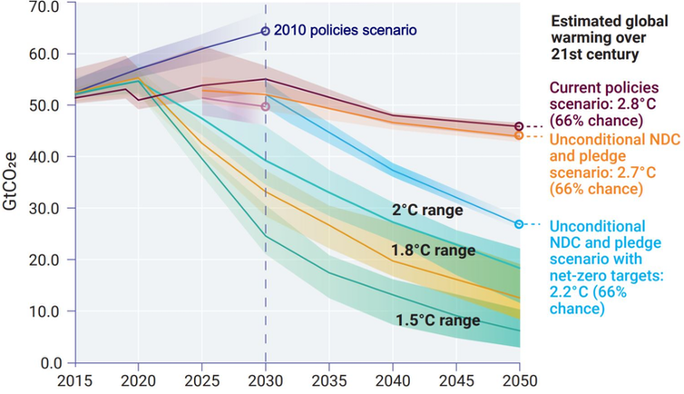
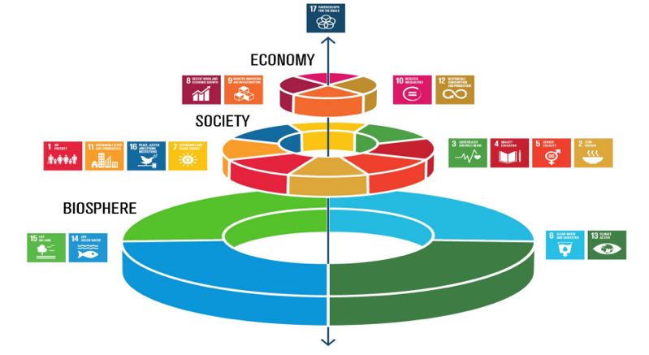
Targets have been defined but progress is minimum
GHG
Reductions by 2050
Paris
Accords
Needed for a 1.5C scenario
Committed mitigation actions fall short compared to what is needed
17 SDGs covering all sectors
Contradictions among many of them
(economic growth is one of the indicators)

Slide 7
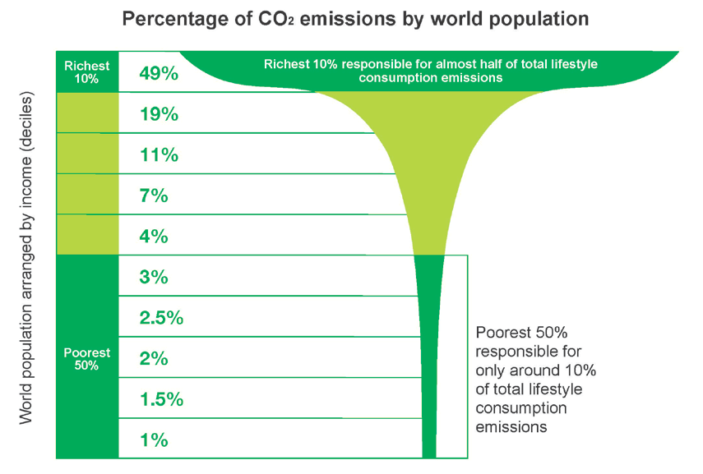
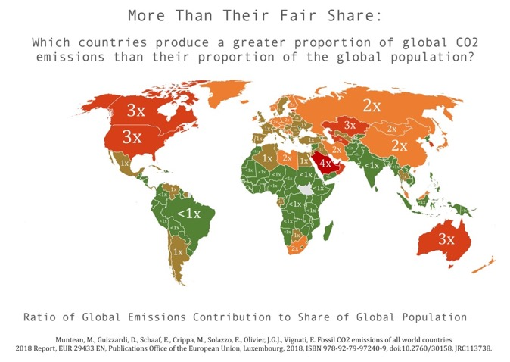
Environmental injustice: inequality in emissions
Social inequality in greenhouse gas emissions:
the richest 10% are responsible for almost 50% of emissions.
Historically the 23 richest countries have emitted as much as the remaining 150.
NOTE: Inequality is also high within each country

Slide 8
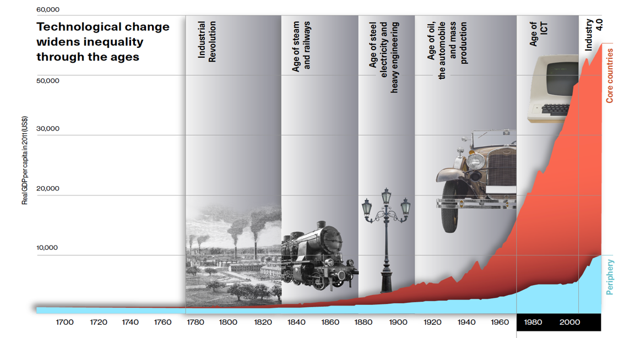
Social crisis: growing GDP = growing inequality
Technological change and inequality
Core: USA, Western Europe, Canada, Australia New Zealand, Japan. Periphery: rest of the world
Technological change has not improved the income gap between the "core countries" and the "periphery”, which has grown steadily.
Globally, 1.1% owns 45.8% of the wealth while 55% owns 1.3%.

Slide 9
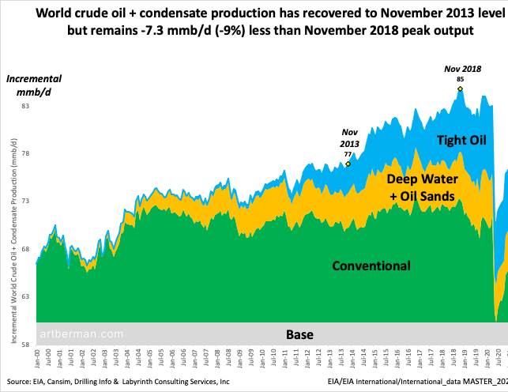
2018: the peak of world oil production
Global crude oil production in million barrels per day 2000-2021
Since 2005 conventional oil production peaked and remained on an undulating plateau
Global production has only grown thanks to unconventional oil (shale oil from the US, tar sands from Canada, and deepwater oil). These are very expensive and/or low-quality resources.
To date, the global peak oil was November 2018.
Since the last decade, high price volatility has reflected the lack of equilibrium: prices too high for the economy and too low for oil companies to continue extracting what is left.
Art Berman, 2021

Slide 10
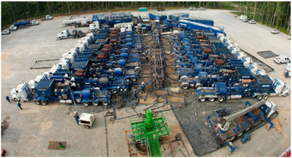
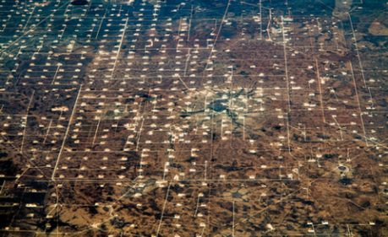
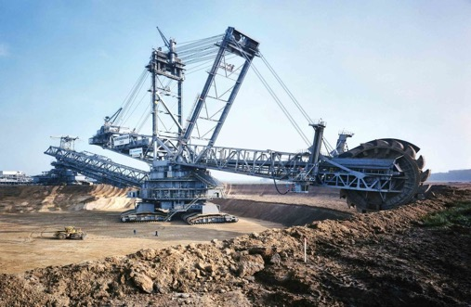
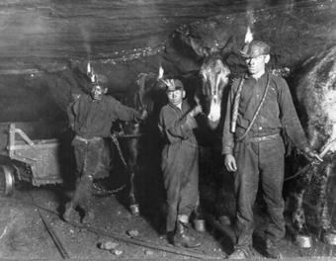
Physical basis of the cost increase: the minimun effort law
The best quality, easier to extract and, therefore, less expensive resource is always exploited first. As the easiest stuff is over, there is an increase in extraction costs and energy costs: we need more money and energy to produce the same resource.
100 years later
100 years later
This law also applies to renewables

Slide 11
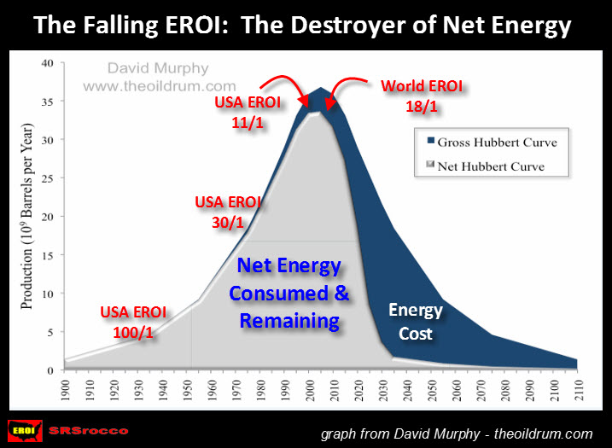
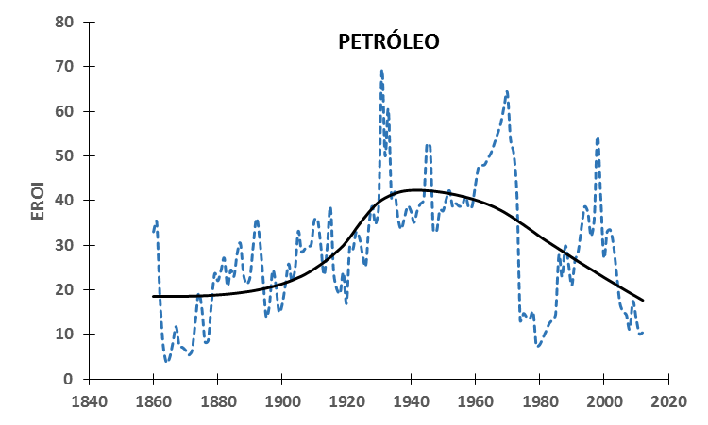
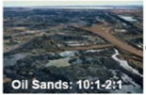
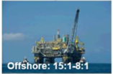
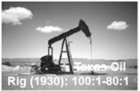
The falling Energy Return On Invested (EROI) means less
net energy available for the society and economy
OIL
Court & Fizaine (2017)
The world EROI has been steadily falling
Due to the decreasing energy return, the increase in oil and gas production does not translate into a similar increase in available energy.
The U.S. needs to drill 100 times more wells and 100 longer wells to produce the same amount of oil as Saudi Arabia. In addition to requiring additional energy to carry out fracking.

Slide 12
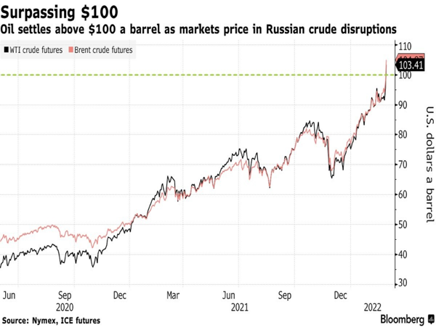
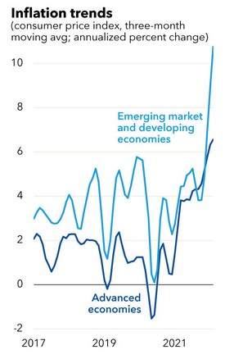
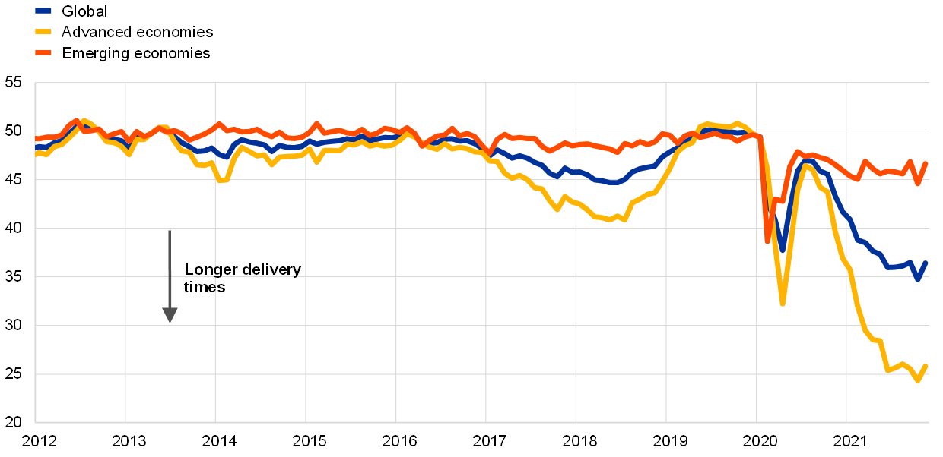
Global consequences: the present situation
Increase in the prices of all industrial and agricultural goods → increase in the consumer price index (8 - 10%)
Disruption of global supply chains and critical industrial inputs: microchips, plastics, fertilizers etc,
Forced decrease in economic activity (blamed to COVID and on the Russian- Ukrainian war and..)
This is not a temporary issue but a structural problem
The problem is not in the moderate recovery in demand, but in the scarcity of supply and particularly in the rising cost of all fossil fuels.
The crisis has been brewing for more than a decade, but through lower interest rates and growing indebtedness the central banks - had managed to postpone it.
(See the work by Antonio Turiel on the subject)
In the past decade, an oil price of 90 USD/barrel has been too low for the industry to invest but too expensive for the economy.

Slide 13
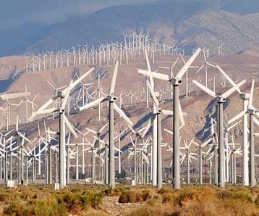
The response from the “status quo”:
MORE OF THE SAME… BUT GREEN
Well .. we need to save the planet without
changing the system that has destroyed it
Any ideas?
  GREEN GROWTH
  GREEN ECONOMY
  GREEN DEAL
  GREEN RECOVERY
  “GREEN” ENERGY
SOLUTIONS: Technology (digital, large-scale renewables, geoingeneering)
Corporate driven, top-down projects; Extractive logic

Slide 14
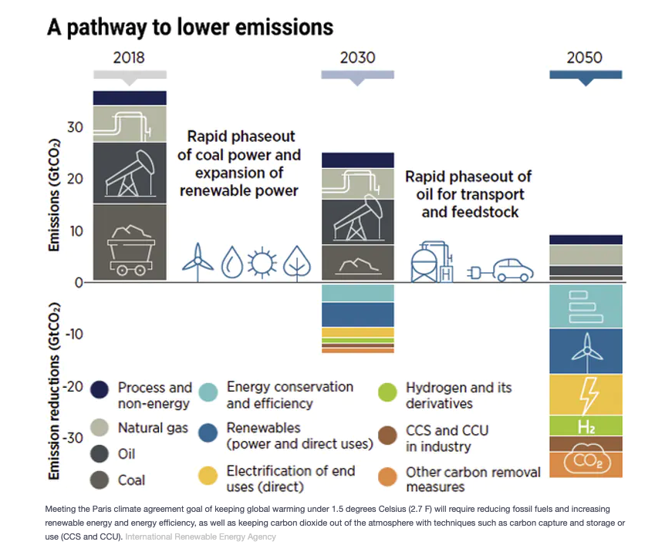
Climate mitigation scenarios from international agencies are based on the greeen growth paradigm
Assume increased economic activity and consumption
Massive and very fast penetration of renewable energy (solar, wind)
Reliance on high cost storage technologies like H₂ or
Massive deployment of geoengineering technologies like CCS and BECCS
Fuente; IRENA, World Energy Transitions Outlook, 2021

Slide 15
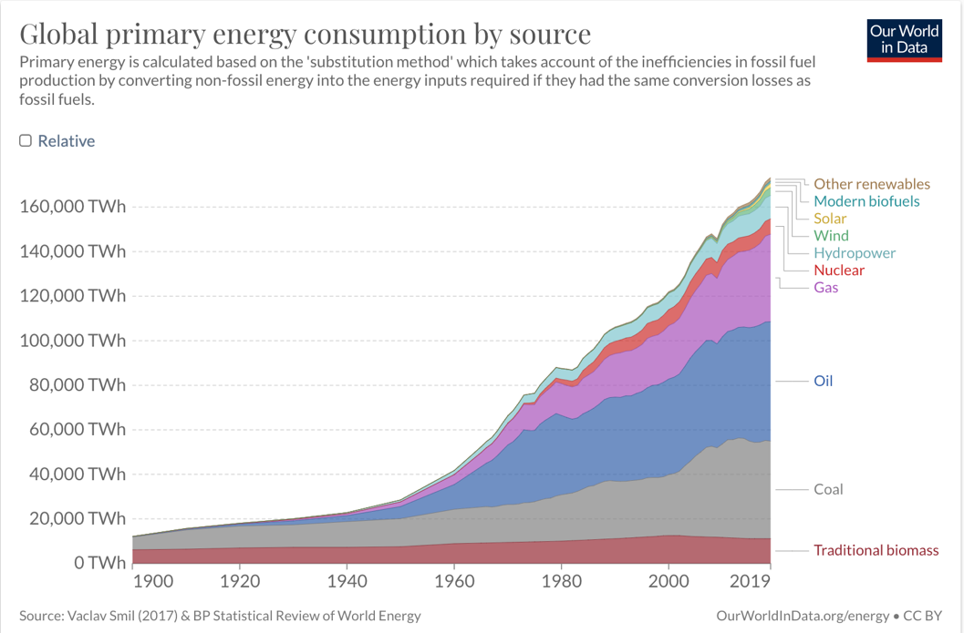
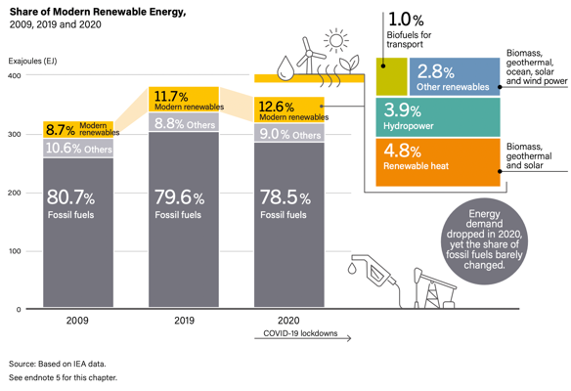
However… So far there has not been a transition but an addition of renewables to the current energy mix
From 2000 to 2020
renewables only increased 3%
within the global energy mix
As for power, its contribution was 28% in 2019 (16% from hydroelectric generation).
NOTE: Electricity is only 17% of the total energy matrix

Slide 16
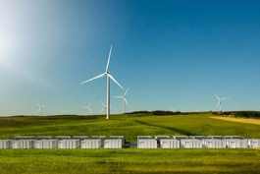
The energy sources of the future are necessarily renewables but ...
Renewables with the highest growth potential (wind and solar) have several limitations:
  Low energy density (much lower than FF)
  Lower Energy Return on Investment (EROI)
  Irregularity of supply (intermittency)
  Expensive and limited storage (batteries, pumped hydro)
  The building of the infrastructure of renewable sources depends on fossil fuels for energy (mining, construction, maintenance) and materials (petrochemicals: resins, lubricants, plastics, etc.)
  Raw materials and critical elements for their building are non-renewable and/or not recyclable: cement, steel, lithium, cobalt, nickel, cadmium, aluminum, copper, gold, silver, rare earths...
  There are not enough reserve of many elements to build the enormous infrastructure needed to substitute FF

Slide 17
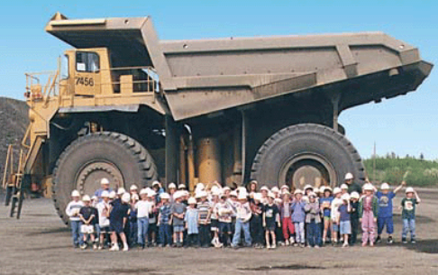
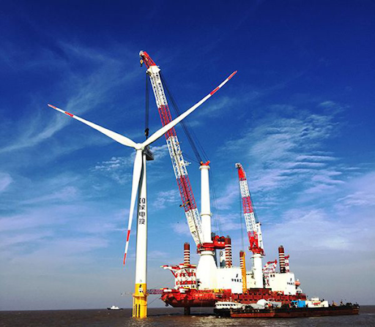
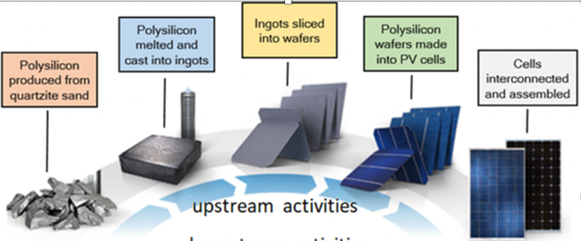
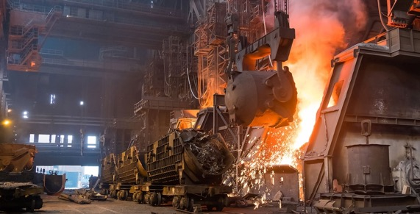

The material limits of the renewable transition
Dependence on fossil fuels at all stages of the life cycle
Mining
Installation
Installation
Steel production
Solar PV panels production
Solar and wind plants require fossil energy for the mining of minerals, the manufacture of generators or panels, the construction of the plant, its maintenance and for the dismantling of the plant at the end of their life cycle
Maintenance

Slide 18
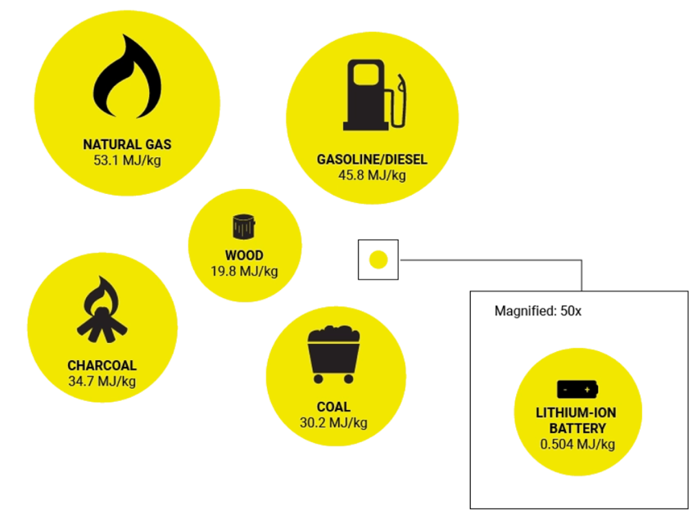
The limits of renewables: Energy density of storage
The energy density of electrical storage systems (batteries) is also much lower than fossil fuels or even wood.
The best lithium-ion batteries can store 1MJ/Kg and it is expected that it can reach 5MJ/Kg... less than a third of the energy density of a potato...

Slide 19
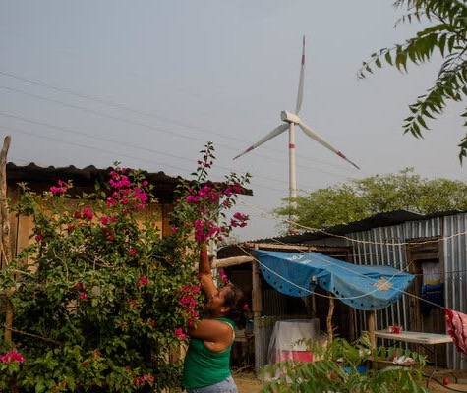
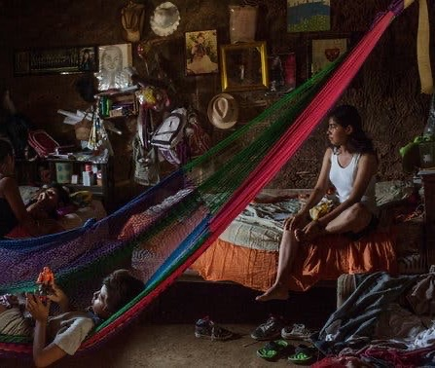
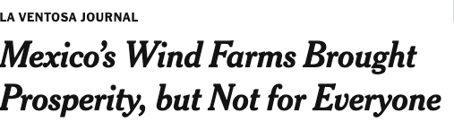
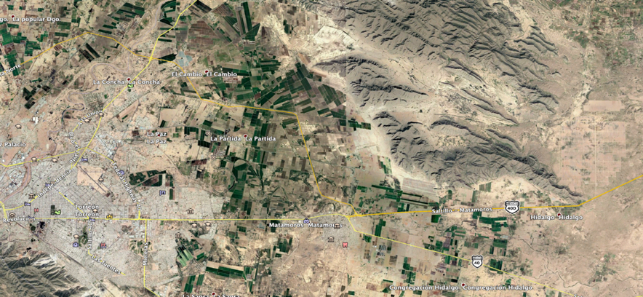
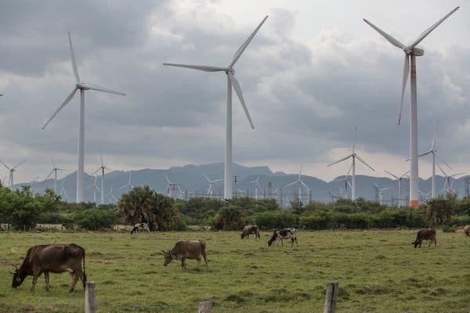
The Case of the “Energy Reform” in Mexico: Renewables
to make the rich… richer!
We need to ask:
ENERGY FOR WHAT?
ENERGY FOR WHOM?
WHO DECIDES?
WHO BENEFITS?
WHO GETS THE
IMPACTS?
Torreon City - 600,000 inhab.
Electricity Consumption 1.6 TWh/a
750 MW Solar Park, 1,600 ha

Slide 20
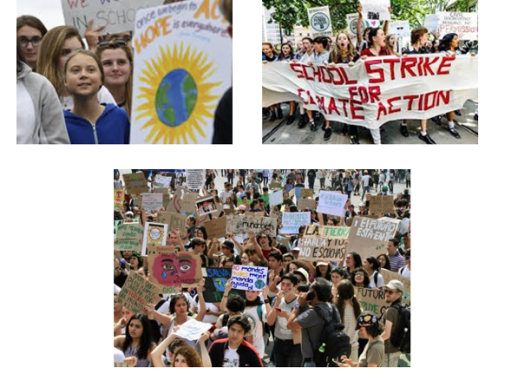
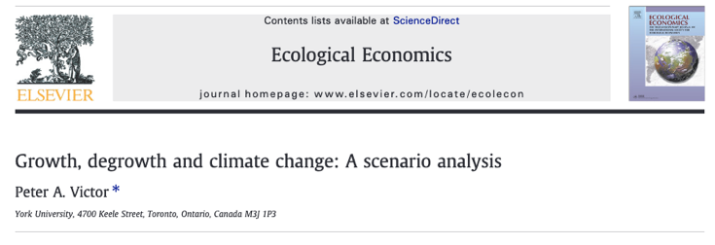
Mounting criticism from different sectors… an urgent need for radical change
Any transition towards sustainability can only be effective if far-reaching lifestyle changes complement technological advancements. However, existing societies, economies and cultures incite consumption expansion and the structural imperative for growth in competitive market economies inhibits necessary societal change.
The gravity of the situation requires fundamental changes to global capitalism, education, and equality, which include inter alia the abolition of perpetual economic growth, properly pricing externalities, a rapid exit from fossil-fuel use, strict regulation of markets and property acquisition, reigning in corporate lobbying, and the empowerment of women. Bradshaw et al. 2021

Slide 21
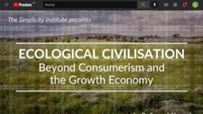
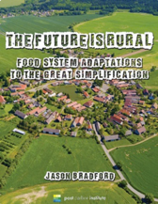








The true way forward….
From “growth”, “global”, “corporate”, “standardized” “inequity”, “violent” “individuals,” “competition” and “male-dominated” to
“degrowth”, local (polycentric), democratic, diverse, self sufficient, just, non-violent, cooperation, adaptation, resilient; gender equity

Slide 22

The way forward … basic needs approach
Using an end-use approach to model future global energy use Millward-Hopkins et al find:
75% reduction from BAU;
30% from IEA SDS scenario
Reduction
in
energy use

Slide 23



Just and Sustainable Energy Transition in Mexico
130 million people
2 million km² land area
11th largest economy
12th GHG emitting country
Second with highest inequity within OECD countries
14th oil producer
20th in oil reserve (from 5th in 1980)

Slide 24


Mexico's energy predicament
Mexico faces four major energy problems:
1) Geological decline of fossil fuel production;
2) High dependence on imported refined products and natural gas that affects energy security and sovereignty;
3) Growing social and environmental impact of energy production, from climate change, local air pollutants, soil acidification or conflicts over land and water use.
4) Inequality of consumption:
the richest decile consumes 8 times more than the poorest;
50 million people live in energy poverty (40% or total population)
96,500 localities
in energy poverty

Slide 25

The current situation: Mexico's energy mix
Power generation 2021
Ferrari and Palacios, 2022
https://obtrenmx.org/generacion_sen
Fossil fuels account for 85% of gross supply. Renewables are 7.5% of the domestic energy supply excluding traditional biomass, 13% if included,
Renewables represent ~23% of power generation: 9.9% hydroelectric, 6.5% wind, 5.5% solar, 1.3% geothermal; 3.4% nuclear.
Electricity is only 20% of energy consumption; Renewables are not just electricity!

Slide 26


Two confronted visions not leading to sustainable energy transitions
The energy discussion in Mexico
The business vision of the energy transition: green capitalism
Former Mexican president Peña Nieto opened the Mexican energy sector to private capital. National, and international corporations invested in large-scale renewable projects following an extractivist vision and with increasing social opposition.
The statist vision of AMLO: fossil capitalism with State leadership
The current administration´s sees large-scale State-controlled renewable projects and strengthening the state-owned oil sector as the basis of the Mexican energy strategy. While it represents an improvement in some aspects, it remains a short-term extractivist vision as well.

Slide 27




A paradigm shift to promote a sustainable and just energy transition in Mexico n
Managing the decline in oil production
Promote a reduction and a profound change in the model of energy consumption (public transport, energy savings in buildings, efficient industry focused on internal needs, local economies)
Transition to LOCAL, renewable sources at small/mid scale both thermal and electric (wind, solar, biomass, geothermal, hydraulic)
Ensure UNIVERSAL access to energy services (cooking, cooling, water heating, thermal comfort..)
Democratize energy production through distributed generation in cooperatives, small businesses and community social enterprises.
Notes:
La discusión sobre renovables NO SE PUEDE SEPARAR de la transición a una sociedad diferente.
Manejar el declive -- implica REDUCIR LA DEMANDA vía uso eficiente y cambios en movilidad, procesos industriales, etc.

Slide 28




Advancing the new paradigm in Mexico…
The National Strategic Program on Energy Transition from CONACYT
Science/Engineering/Innovation programs oriented to have a positive socio-environmental impact, beginning with the most vulnerable populations
Structural Transformation of the Energy System with 4 themes:
  Mobility, Green Industry, Rural Energy Systems- Energy Access; Democratization of Energy Production
56 Projects all over Mexico
  Transdisciplinary and systemic approach (social scientists, engineers)
  Co-creation of knowledge with local users (Science for and WITH the people)
  Learning Communities (Academic Inst.; Govt, Local Organizations)
  ”Living Labs” as inputs to public policy and further replication

Slide 29





Universal access and democratization of energy
Local renewable energies are key to reactivating and dignifying rural communities in Mexico (i.e, sources of employment, added value to products)
Implementation of community energy systems and renewable energy ecotechnologies for:
1) Housing: cooking food, water heating, lighting and basic appliances, water supply and treatment
2) Small local industries (bakery ovens, fruit drying, pottery, carpentry..) and community services (clinics, schools)
Direct impact on health, poverty reduction, employment, access to food and water clean and accessible energy…
Biogas
Ecological stoves
Solar energy
Wind turbines

Slide 30






Example: Renewable Energy Ecotechnologies for Rural Areas
Canoa Solar, Ecuador
Sistema de riego solar. Fuente Solaract
Calentadores solares. Fuente CONUEE
Estufas eficientes de leña
Secador Solar . Foto: Joel Moreira.
Biodigestores en Tlalpan, Tláhuac, Milpa Alta y Xochimilco.

Slide 31






Participatory Innovation Process
Understanding Users
Needs
Co-creation of Solutions
Training and Follow Up/Monitoring
Creation of Local Cooperatives
Capacity Builing
Building Supply Chains

Slide 32



Concluding Remarks
The present dominant economic model based on increasing consumption, inequity and economic growth (green or not) is totally unsustainable
More than ever we need to construct “other imaginaries” of social change (see for example, Fernandez-Savater) and of society at large (more diverse, localized, polycentric..) based on ethical principles and sufficiency -we are persons NOT consumers!-
The new energy system will first seek to reduce cosumption and inequities making the most efficient use of local resorces/technologies appropriate to the local contexts
We need many may committed engineers working hand to hand with social scientists, and local communities!
Notes:
La tecnología nos ha cambiado muchísimo –tiempo, espacio, lo que es un “ser humano”, relaciones sociales, el mundo del trabajo- tiene un enorme potencial para apoyar un desarrollo más sustentable
PERO CON EL MODELO ACTUAL MUCHAS DE ESTAS PROMESAS SE HAN QUEDADO INCUMPLIDAS –LA TEC. HA PERMITIDO Y ACELERADO EL DETERIORO AMBIENTAL Y NO LLEGA A LOS QUE MÁS LA NECESITAN PARA RESOLVER NECESIDADES BÁSICAS
Debemos cambiar el rumbo YA, la ecotecnología ofrece “otro imaginario” (local, inclusivo socialmente, solidario, consumo responsable, amigable con el ambiente) articulado con un movimiento de cambio socio-ambiental más amplio puede ayudarnos:
La verdadera utopía es seguir con el rumbo actual --- parafraseando a Freire, hay muchos imaginarios posibles.. “pronunciemos” colectiva y solidariamente el mundo con este proyecto ecotecnológico para un mejor planeta!!

Slide 33

For further information…
Omar Masera
  omasera@gmail.com
Luca Ferrari
  luca@unam.mx
Prototipo de Casa Ecológica
desarrollada por el IMTA

Slide 34
Additional Material

Slide 35
Basic Needs Approach to Energy Planning

Slide 36



Distributed Generation of Residential Heat and Electricity with Biomass in Denmark
Renewables and democratization of energy
Distributed electricity generation self-managed by communities
Bioenergy from agricultural waste (wheat straw)
13% electricity
21% heat
14 large CF plants
> 500 plants operated by communities
Long-term public policy; development of local technology; Incentives for producers; benefits to local communities

Slide 37

Contribución de las renovables en el uso final
https://www.ren21.net/reports/global-status-report/
La contribución de renovables a la generación de electricidad fue del 28.0% en 2019 (15.9% procedente de generación hidroeléctrica).
NOTA: la electricidad es solo 17% de la matriz energética total

Slide 38


Qué implica sustituir los CF por renovables en el transporte
No hay suficiente reservas de minerales críticos solo para las baterías.
Implicaría descubrir:
7.13 depósitos de cobalto como los de la RD Congo
6.97 depósitos de litio como los de Australia
6.28 depósitos de níquel como los de Indonesia
ADEMAS NO HAY TIEMPO: con la tasa de extracción de 2018 tardaríamos 56 años para el cobalto, 72 años para el litio y 67 años para el grafito
Data from Michaux

Slide 39



Los límites materiales de la transición a renovables
Materias primas no renovables para la infraestructura “renovable”
La industria de las fuentes eólica y solar y en general el sector eléctrico y electrónico está estrechamente ligada a la minería de cobre, litio, cadmio, cobalto, zinc, aluminio, níquel, plata, tierras raras etc.
Sustituir combustibles fósiles por “renovables” significa pasar de la extracción de hidrocarburos a la extracción de minerales

Slide 40




Sustainable energy transition:
reduced residential/commercial
energy use
Bioclimatic design of dwellings/buildings; efficient appliances;
Construction standards and maximum consumption per appliance (refrigerator, AC, spotlights, stove).
Massive program of solar heaters, zero waste, re-use of containers and containers.
Laws to prevent planned obsolescence
Promote food production with a low carbon footprint (agroecology, urban gardens) and local consumption networks.

Slide 41



Sustainable energy transition:
reduction of energy consumption for transport
Specific measures of immediate effect that do not imply an economic cost
Reduce the maximum speed.
Prohibit the sale of vehicles with a yield < 15 km/l
Discourage the use of the private car
Measures that require more time and/or investment:
Massive increase in electrified public transport
Promote the use of bicycles and pedestrian mobility
Redesigning cities to live close to the workplace and services
Teleworking and virtual work centers within walking distance from home
Reduce the consumption of products imported or produced from distant places

Slide 42


Sustainable energy transition:
industrial sector
Increase efficiency in energy-intensive industries (refineries, cement, steel, chemical)
Promote efficient cogeneration in mills, refineries and others
Substitution of fossil fuels for thermal uses with bioenergy and concentrated solar energy.
Caldera de Biomasa
Industria Tequilera
Strategic planning: redirecting resources towards sustainability
stop betting on energy-intensive industries (export, automotive, aviation, international tourism, etc.)
reorienting the economy towards domestic needs: food self-sufficiency, public transport, health, education
Cogeneración CYDSA, Coatzacoalcos 80 MW

Slide 43



The physical and ecological limits of the growth paradigm
Mainstream economic school (Neoclassical Economics) ignores physics, geology, and ecology by failing to consider that economics is a subsystem that depends on energy and material supply (input) and produces waste and degradation (output)
Neoclassic Economics
OUPUT:
Waste,
Pollution
INPUT: Energy,
Raw materials
Due to this limitation, neoclassical economists propose infinite exponential growth, something physically impossible and environmentally harmful.

Slide 44
What has been achieved so far?
GHG
Reductions by 2050
Paris
Accords
Needed for a 1.5C scenario

Slide 45


Ejemplo: Sistemas de Energía Renovables diseñados, implementados y apropiados por las comunidades locales
Modelos Energéticos
Proyectos a escala pequeña/mediana; con tecnología nacional; gestionada por las comunidades/cooperativas locales; los beneficios se quedan en el lugar
Diseño participativo “diálogo de saberes”, manejo multipropósito de recursos y estrategia multi-fuente y multi-tecnológica adecuada los diversos contextos bioculturales
Oportunidades: calor de proceso, electricidad, movilidad..
Creación de “prosumidores” de energía (productores y consumidores) para crear valor agregado y empleo local

Slide 46




Intensidad energética: uso de suelo
Para reemplazar una central de 1000 MW de potencia
Por fuentes renovables se requiere:
Generación anual
6,000 GWh
Superficie
1 km2
5,500 MW
3,000 MW
2,500 MW
70 km2
150 km2
220 km2

